Slide 1
Deployment and Operations for Software Engineers 2nd Ed
Chapter 16 – The Future

Slide 2
Outline
Transitioning to DevOps
The evolution of DevOps
AI Engineering
Keeping up

Slide 3
Developing a pilot project
Some ideas to help if you are asked to develop a plan for your organization to adopt DevOps practices.
The four DORA metrics of lead time for changes, change failure rate, deployment frequency, and mean time to recovery will be useful
Determine the current values of these metrics
Devise targets you would like the organization to achieve.

Slide 4
Cost estimates
Cost estimates for the adoption of DevOps practices together with the improvements in the metrics will enable your management to determine whether they wish to invest in adopting DevOps.
To estimate costs, organize a pilot project.
You will need a budget for the pilot project.

Slide 5
Management pitch
Put together a pitch for your management that includes
activities from other organizations in your field,
potential benefits,
potential pilot project,
what you expect to learn from the pilot,
the time and cost for the pilot.

Slide 6
Outline
Transitioning to DevOps
The evolution of DevOps
AI Engineering
Keeping up

Slide 7
Evolution of DevOps
There are three trends that will shape the immediate future of DevOps.
Standards and defacto standards
The evolution of markets, tools and vendors
the application of DevOps to domain specific problem areas.

Slide 8
Standards
ISO/IEC/IEEE 32675:2022 Information technology — DevOps — Building reliable and secure systems including application build, package and deployment
This document provides requirements and guidance on the implementation of DevOps to define, control, and improve software life cycle processes. This document specifies practices to collaborate and communicate effectively in groups including development, operations, and other key stakeholders.
https://www.iso.org/standard/83670.html

Slide 9
De facto standards
A de facto standard is a custom or convention that has achieved a dominant position by public acceptance or market forces
Tools may become de facto standards and other tools will be built on top of them.
E.g. OWASP is a defacto standard. Scanning tools have been created that invoke OWASP during runtime.

Slide 10
Evolution of markets, tools and vendors
There are currently too many vendors
Vendors will consolidate and tools will disappear.
An associated trend is the growth of multi-vendor cloud environments.

Slide 11
Vendor agnostic tools
Some tools are cloud provider agnostic.
Cloud agnostic tools have the virtue of being usable on different cloud providers.
They have the disadvantage of not being able to take advantage of cloud provider specific features.

Slide 12
End-to-end deployment pipeline tools
Expect the growth of end-to-end deployment pipeline tools.
Currently, specialized tools exist for different portions of the DevOps process cycle
Tool chains from a single vendor that are integrated and that cover all or much of the cycle will become common.
Expect to see the emergence of tool language translators that translate from one vendor’s tool chain to another.

Slide 13
Use open-source tools
Successful open-source tools tend to have a longer lifetime than proprietary tools.
These tools, typically, are supported by one or more companies that provide employees to support the tool.
Using open-source tools will help your organization avoid vendor lock in.

Slide 14
Domain specific problem areas
Another trend that will gain prominence in the future is the growth of domain specific problem areas.
Three such domain specific problem areas already exist.
DevOps for Machine Learning.
DevOps for government or other organizations that contract their software development to external organizations
Database DevOps.

Slide 15
Outline
Transitioning to DevOps
The evolution of DevOps
AI Engineering
Keeping up

Slide 16
Three aspects to AI Engineering
MLOps
Customizing Foundation Models
Integrating to non-AI lifecyle

Slide 17
MLOps
MLOps is the term given to the preparation of a Machine Leaning model designed for a single task.
It builds on the lessons of DevOps in terms of managing versions.

Slide 18
MLOps practices
Data versioning and management:
Experiment tracking:
Model versioning:
Model training and retraining:
Model deployment:
Model performance monitoring

Slide 19
`Customizing Foundation Models
Foundation Models are general purpose models trained on massive amounts of data.
They need to be customized to achieve specific tasks.
Customization techniques are
Fine tuning
Prompt engineering
Retrieval Augmented Generation

Slide 20
Integration with non-AI lifeccyle
The figure on the next slides shows a complete lifecycle of an AI system. MLOps and FM customization are shown at the bottom.
They are integrated with the non-AI portion during the build stage.

Slide 21
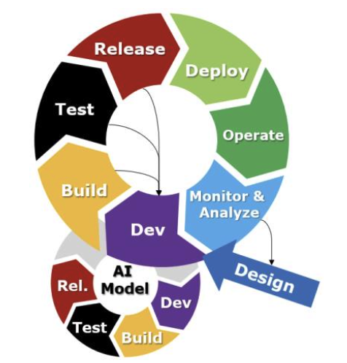
AI Engineering Lifecycle Overview

Slide 22
Outline
Transitioning to DevOps
The evolution of DevOps
AI Engineering
Keeping up

Slide 23
Changes in the field
Every decade or so, the computer industry undergoes a radical transformation.
The 1970s saw the introduction of networks,
the 1980s the introduction of personal computers,
the 1990s were when the world wide web was introduced,
the 2000s saw the cloud,
the 2010s, DevOps.
In the 2020s, AI is a transformative technology.

Slide 24
Keeping up with emerging technologies
You will need to keep up with emerging technologies.
You need to become conversant with neew technologies and put some thought into how it might impact your career.

Slide 25

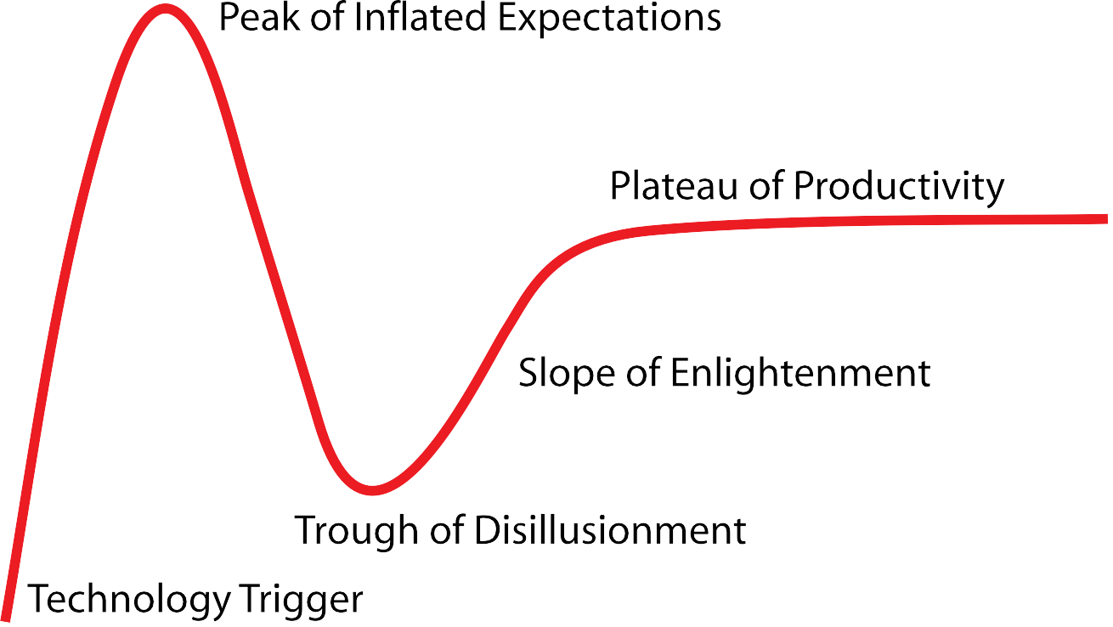
Gartner hype cycle
Choose portion of the curve that reflects your desired career path.
Pay attention to a new technology that gets to your chosen portion of the curve.

Slide 26
END OF CHAPTER 16

